Slide 1
Lighting
Part One - Theory
based on Chapter 6

Slide 2
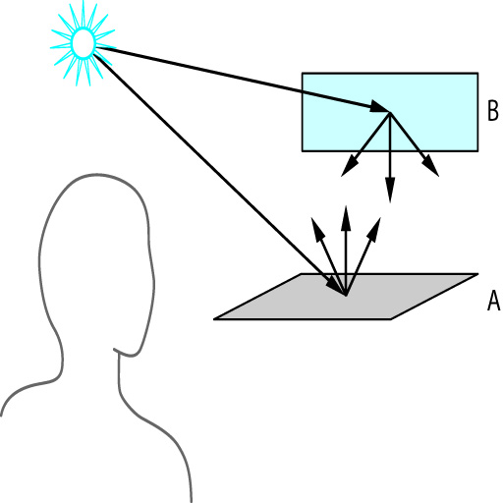
Lights in the real world
Lights bounce off surfaces and reflect colors, scattering light in many directions.
recursive process
Numeric methods are not fast enough to generate true lighting effects in real-time
close is usually good enough
So… We use a simpler lighting model, such the Phong Reflection Model
figure 6.1

Slide 3
Components of Lighting Model?
What are the components (variables) of a lighting model?
Light Sources
Location
distance
direction of light rays
Color
red, green, blue
Surfaces
Color
Location
orientation
Material
reflectivity

Slide 4
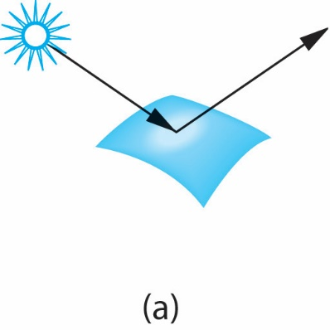
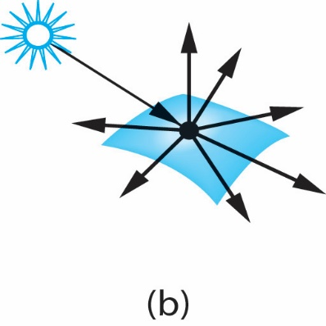
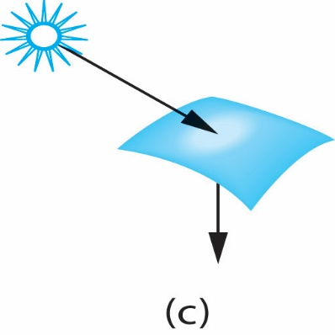
Surface Types
Specular
mirrors are perfectly specular
Diffuse
perfectly diffuse scatters light in all directions, thus appears the same to all viewers
Translucent
Emissive
We must specify ambient, specular and diffuse for all surfaces.
figure 6.4

Slide 5
Types of Lights
Ambient
easiest to model
Point Sources
scene with a single point source tend to have high contrast, so add some ambient
Spot Lights
same as point source, but light does not emit in 360º
Distant
reflection across a surface does not change from point to point
[ x, y, z, 1 ] is a local point
[ x, y, z, 0 ] is a distant point

Slide 6
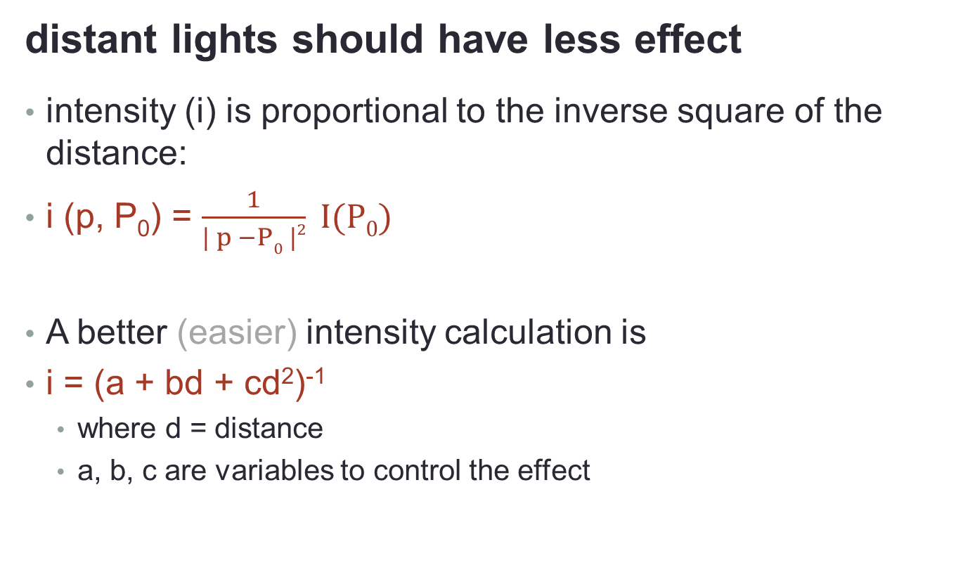
light intensity
distant lights should have less effect
intensity (i) is proportional to the inverse square of the distance:
i (p, P₀) = $\frac{1}{| p −P0 |2} I(P0)$
A better (easier) intensity calculation is
i = (a + bd + cd²)⁻¹
where d = distance
a, b, c are variables to control the effect
I(P₀) = intensity of light source at P₀
p = a point to be lit

Slide 7
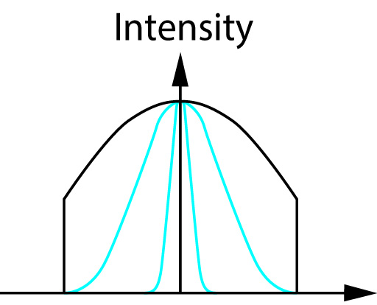
spot light effects
a true spot light is not equally intense from side to side
think of a flashlight
cos ^{e} Φ
exponent e controls the intensity
drop off
figure 6.12

Slide 8
Basic Phong Reflection Model
I = L_{a}R_{a} + L_{d}R_{d} + L_{s}R_{s}
L = light
R = reflection
a = ambient
d = diffuse
s = specular
We calculate the intensity for each point.
Each light source adds more color.
Lights and Reflections have red,green,blue components.
We usually also add a global ambient component.

Slide 9
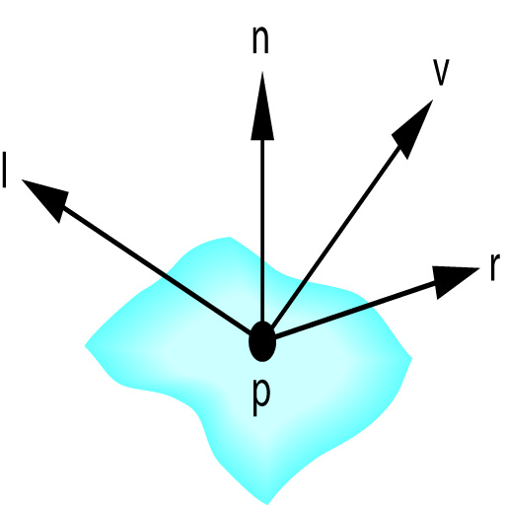
Improved Phong Reflection Model
Uses four vectors
n = normal
v = direction to viewer
l = direction to light source
r = direction of perfectly reflected
light ray
vectors can change from point to point on a surface
figure 6.13

Slide 10
Ambient Component
ambient light reflects evenly across the surface, so calculation is simple
I_{a} = L_{a} K_{a}
where Ka is the material's ambient coefficient
0 ≤ Ka ≤ 1

Slide 11

Diffuse Component
Adding in a reflection angle coefficient for the surface K_{d} and a distance from the light, d, we get:
I_{d} = $\frac{Kd}{a+bd+cd2}$ (l•n) K_{d}L_{d}

Slide 12
Specular Component
To determine glare, we need to factor in the difference between the direction to the viewer (v) and the perfect reflection (r). That angle is Φ.
We also need to account for the shininess (α)
I_{s} = K_{s}L_{s} cos^{α} Φ
α near infinity is a perfect mirror
α between 100 and 500 is metal
What about distance?
What if cos Φ is negative?
max ( (r • v), 0 )

Slide 13
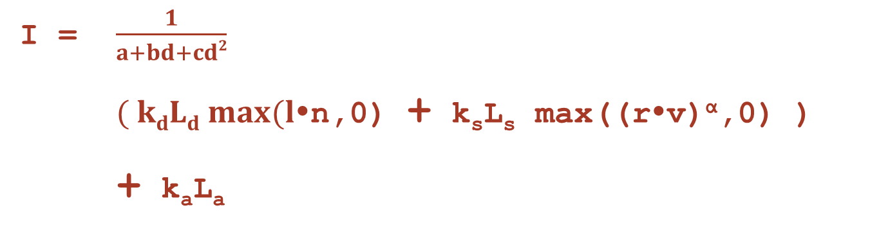
Combining all Components
I = $\frac{1}{a+bd+cd2}$
$( kdLd max(l$•n,0) + k_{s}L_{s} max((r•v)^{α},0) )
+ k_{a}L_{a}

Slide 14
Finding Normal Vectors
Given 3 non-linear points, P1 P2 P3
n = (P3 - P1) X (P2 - P1)
remember to observe the right hand rule
nx = (P3y-P2y)(P2z-P1z) - (P3z-P2z)(P2y-P1y)
ny = (P3z-P2z)(P2x-P1x) - (P3x-P2x)(P2z-P1z)
nz = (P3x-P2x)(P2y-P1y) - (P3y-P2y)(P2x-P1x)

Slide 15
Implementation Issues
Which model do we use
Constant shading with distant source
Interpolative shading with distant source
Constant shading with local source
Interpolative shading with local source

Slide 16
Implementation Issues
Last line of the Fragment Shader:
gl_FragColor = ambient + diffuse + specular;
Where do we compute those values?
inside the application
in the vertex shader
in the fragment shader
some combination of those

Slide 17
Next classes
Lighting Code
Exam #2

